Slide 1
Ernest J. Dronenburg Jr. Assessor/Recorder/County Clerk, San Diego County
Disabled Veterans exemption Ready to serve!

Slide 2
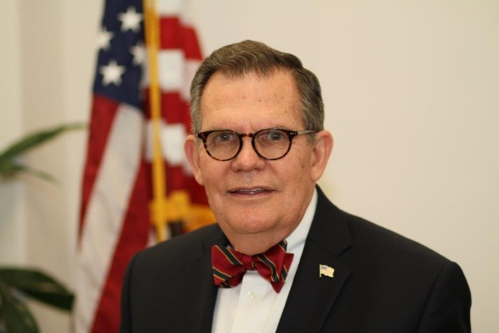
Ernest “Ernie” Dronenburg, Jr. San Diego County Assessor – Recorder - Clerk
San Diego State University Alum
Veteran – United State Coast Guard
Authored CA Taxpayer Bill of Rights

Slide 3
Office of Taxpayer Advocate
Ensure fairness
Provide education
Correct systemic issue

Slide 4
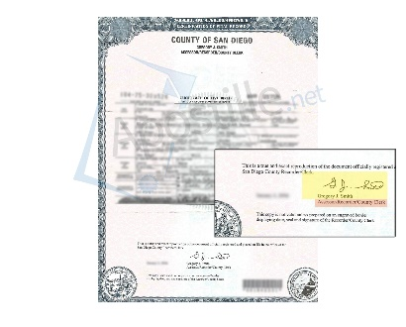
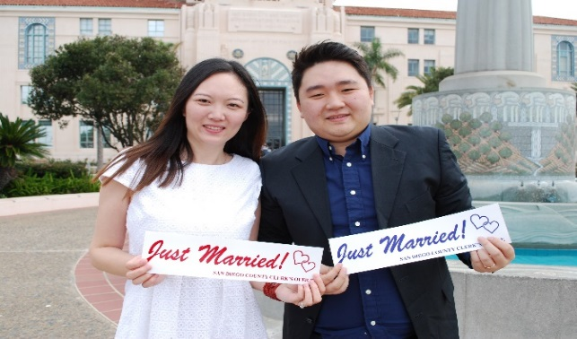
Assessor, Recorder, County Clerk
1. ASSESSOR
Appraise of all real & personal property in San Diego county
$574.9 billion assessed value
1,001,029 parcels
72,572 personal property accounts which include planes, boats, computers and penguins
2. RECORDER
Verify, records, indexes, vital documents, and makes available to the public
584,859 documents recorded in 2018-19
195,516 certified vital records issued annually
includes: birth & death certificates, deeds, and liens
3. COUNTY CLERK / COMMISSIONER OF CIVIL MARRIAGES
Issues and maintains a record of fictitious business names, marriage licenses, and perform civil marriages
23,985 licenses issued in 2018
11,931 ceremonies preformed by ARCC

Slide 5
DISABLED VETERANS’ Property Tax Exemption

Slide 6
What is a Disabled Veteran’s Exemption?
Provided for by voters in the California State Constitution
Property tax reduction of assessed value from on a primary residence
Reduces property taxes and bond / indebtedness lliability
Available to qualified veterans Service-connected disable veterans and their unmarried surviving spouse
Amount changes annually due to inflation

Slide 7
Who is eligible for the Disabled Veterans’ exemption?
Veteran of the United States Military
Must be rated 100% disabled as result of a service-connected disability
Exemption available to a disabled veteran who, because of an injury incurred in military service:
is blind in both eyes
Or has lost use of two or more limbs
Or is totally disabled as determined by the VA or by the military service from which the veteran was discharged.
Or compensated at 100% due to UNemployability
Unmarried surviving spouse of the disabled veteran if:
They qualified for the exemption during the veteran’s lifetime
Death was service connected.
Veteran died on active duty as the result of a service- connected disease or injury.

Slide 8
Total Exemption Savings – 2019 Rates
Two levels of the exemption
1. Basic Exemption:
Assessed Value Reduction $143,273 (up to)
= Property tax reduction of $1,432.73
One time filing
2. Low-Income Exemption:
household income less than $60,490
Additional Assessed Value Reduction of $71,637
A total assessed value reduction of $214,910
= Total Property tax reduction of $2,149.10

Slide 9
Example of the Exemptions Reduction of Assessed Value
Home was purchased for $500,000
Property tax is 1% of sale price
Property Tax Owed: $500,000 x 1% = $5,000 Disabled Veteran Exemption: $139,437 x 1% = $1,432.73 _________
Property Tax Due after Exemption: $3,567.27
ANNUAL SAVINGS Around $1,500

Slide 10
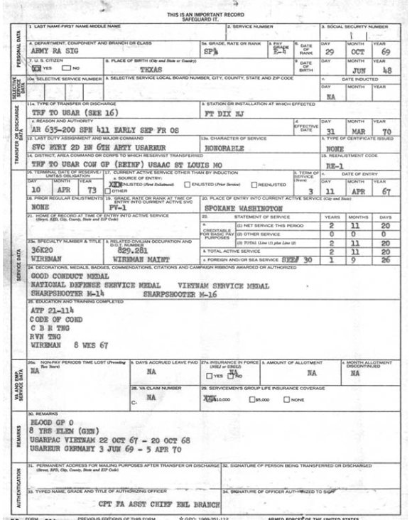
How do I apply?
Apply by emailing ArccDVETS@Sdcounty.ca.gov, snail mail or in person at any of our 5 convenient ARCC offices
file BOE form 261-G, Claim for Disabled Veterans' Property Tax Exemption
Very Easy 2 page form
Available on www.SDARCC.com
One time filing
Copy of the Veteran’s DD214 stating honorable discharge
Veterans Administration rating decision letter indicating 100% service-connected disability and effective date rating
* Low-Income applicants must file an additional gross income sheet – showing income
Annual filing
Need taxes from year preceding

Slide 11
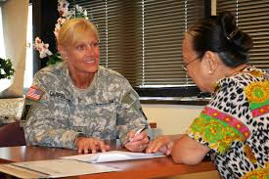
Additional Items for Unmarried Surviving Spouse
Copy of marriage certificate
Copy of death certificate
And All information required for the Veteran applying

Slide 12
When Should I Apply, How Often Do I File, & Is It Retroactive?
file by February 15th for which you seek tax relief – after is a late filing with a 15% penalty
Ex. Bought in March 2018, then you must file by December for 2018 or you only receive an 85% reduction
The exemption can apply retroactively up to 8 years, still subject to late filing penalties.
The VA can retroactively determine disability rating

Slide 13
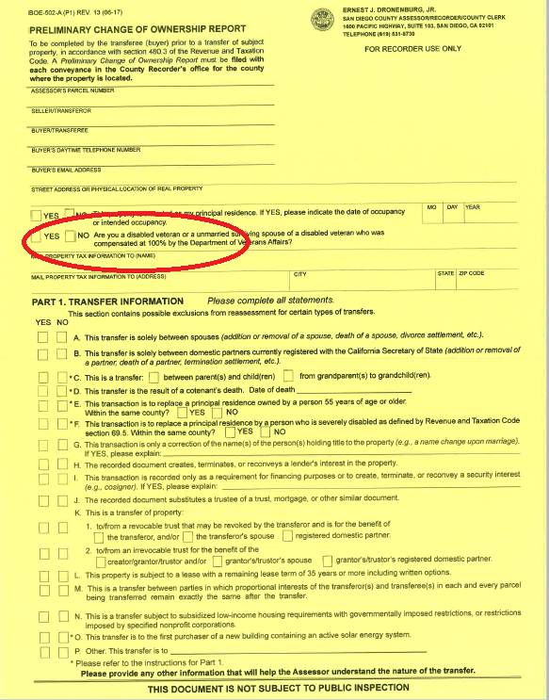
San Diego County Leads the Way: We Changed the CA State Forms To Better Serve Qualified Veterans and Spouses
San Diego led the way for the State of California to Change its Preliminary Change of Ownership Report(PCOR).
Now it asks – “Are you a disabled veteran or unmarried spouse of a disabled veteran who was compensated 100% by the Department of Veterans Affairs?”
If you check yes we now reach out to help you file the Disabled Veterans’ Exemption

Slide 14
Launched “One Million More Thanks” Campaign Veterans Day 2019
Before you pay your property taxes see if you qualify or thank a veteran by referring them to our office to qualify them for the Disabled Veterans’ Property Tax Exemption
Goal is to qualify 1,000 more veterans for the tax break saving them over $1 million
1/1/2018 we had just over 5,000 disabled veterans in the program
By 7/1/2020 our goal is to qualify over 10,000 disabled veterans
This will save San Diego County Disabled Veterans over $14 million in property taxes annually!
14

Slide 15
San Diego County Assessor's Office is the lead County in California for Disabled Veterans’ Exemptions. We qualified 10,138 – AS of May 1st More than Los Angeles & Orange Counties Combined

Slide 16
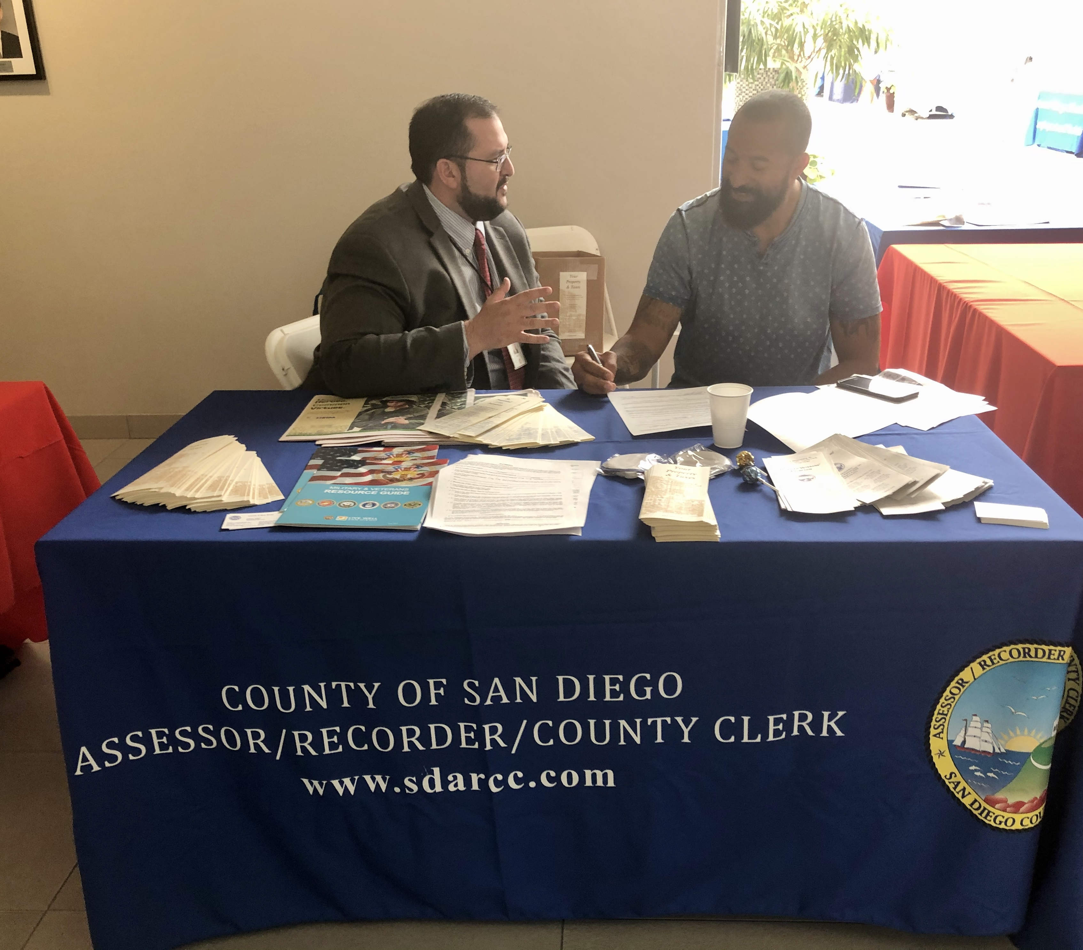
We Are Here To Help!
Key Contact Information:
Forms online at www.SDARCC.com
Call Disabled Veterans’ Unit: 619-531-5773
Email: ArccDVETS@sdcounty.ca.gov

Slide 17
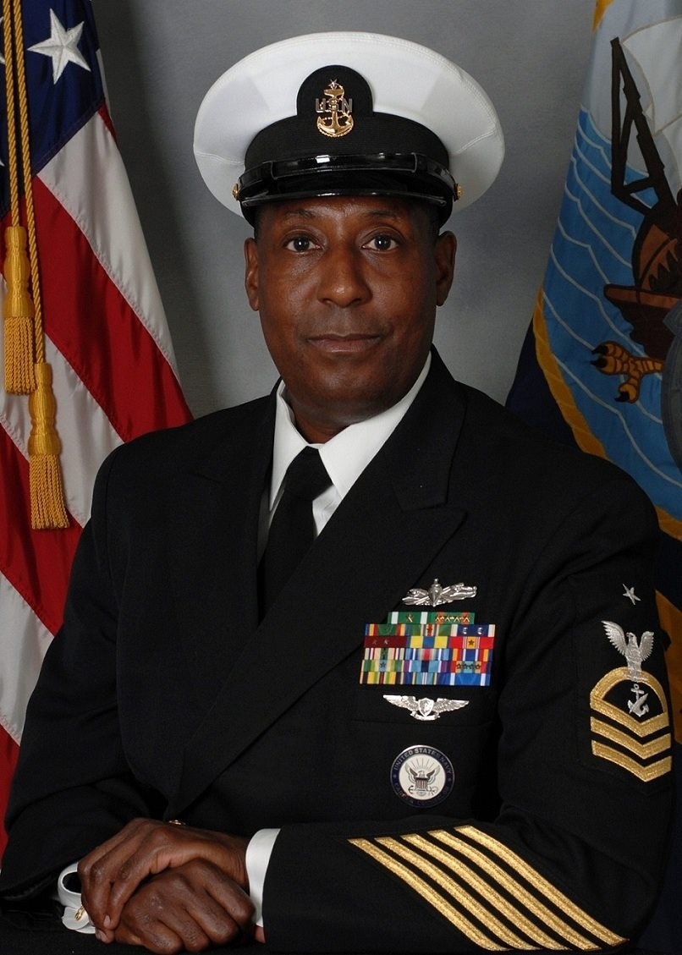
Honoring Robert Calloway
Navy Veterans
Navy Veteran
VAREP Past President
PSAR 2019 President
2020 C.A.R. Director
Assessor’s Advisor on Disabled Veterans Exemption
Passed Away May 2020

Slide 18
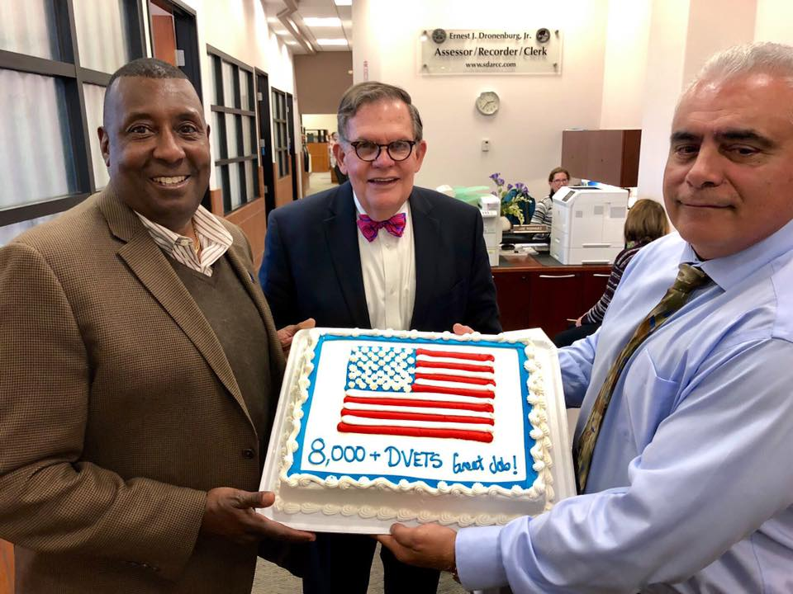
Robert Calloway Memorial Housing Grant
Sponsored by PSAR & CAR HAF
$1,500 in closing costs for veterans
Until funds are exhausted (about 30 grants remain)
Rules:
First time homebuyer
Must use a VA loan
Mortgage loan already approved
Property in San Diego County
Represented by a Realtor®
Apply online
Https://Cdn2.Hubspot.Net/Hubfs/530713/2020%20psar%20haf%20application%20form-5.Pdf

Slide 19
Thank You for To Our Award Winning Partners! We didn’t do it alone!

Slide 20
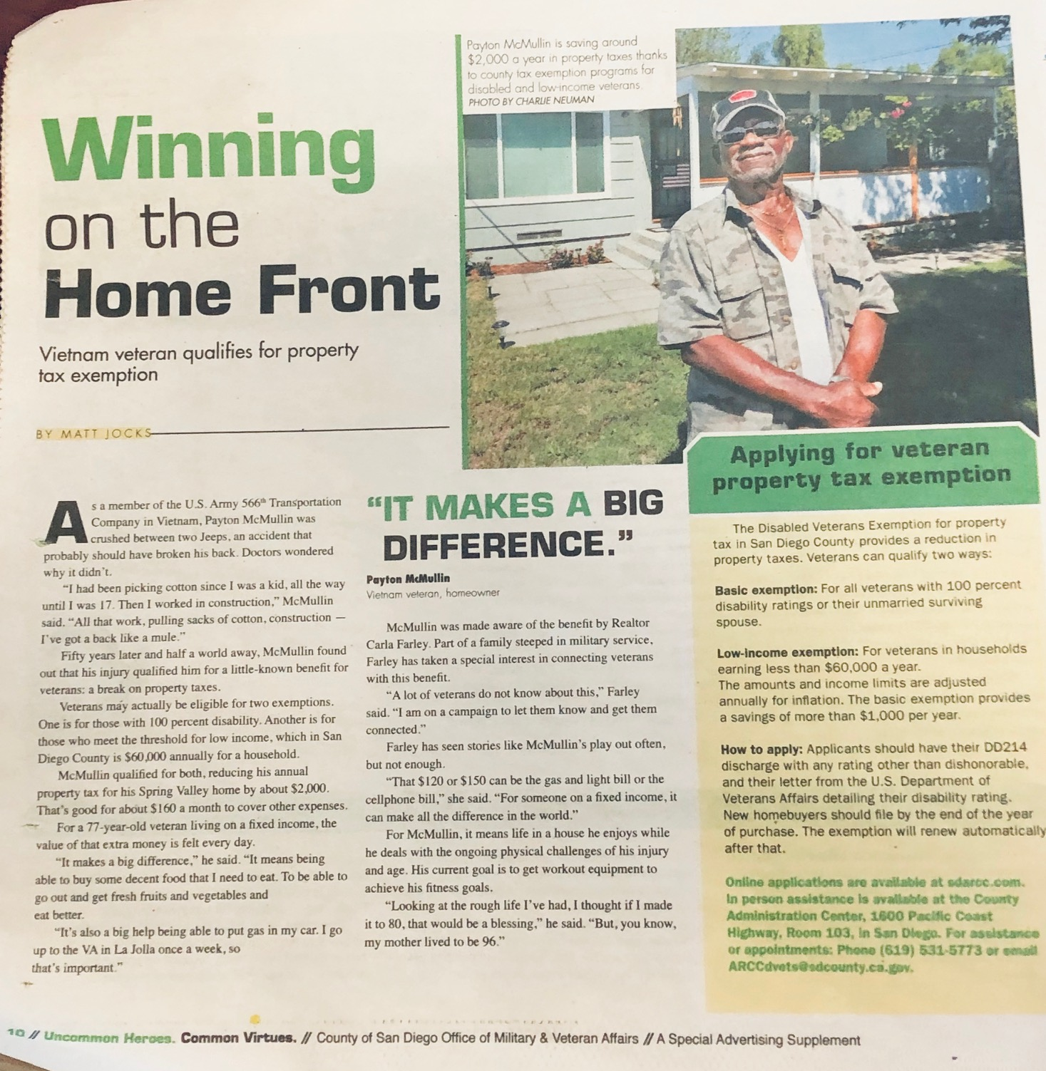
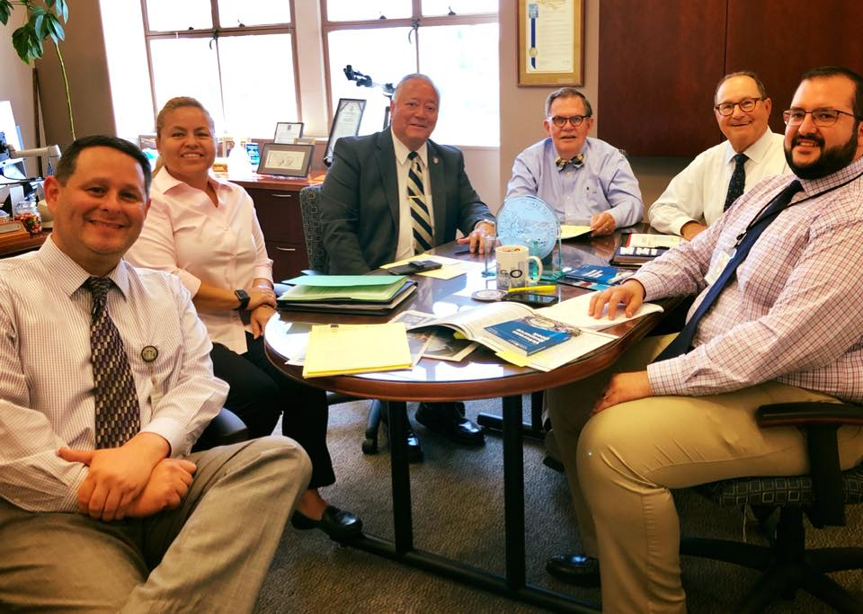
County of San Diego
Office of Military and Veteran Affairs
Pipeline partner - moving from “Rejection Letters” to “Let us help you”
Helped Disabled Veterans appeal less than 100% VA ratings
Found other resources for Veterans through a referral partnership
Cross-trained on the property tax and benefits at the county
Together with our County partner we have achieved great success!
https://www.sandiegocounty.gov/hhsa/programs/ais/veterans_services

Slide 21
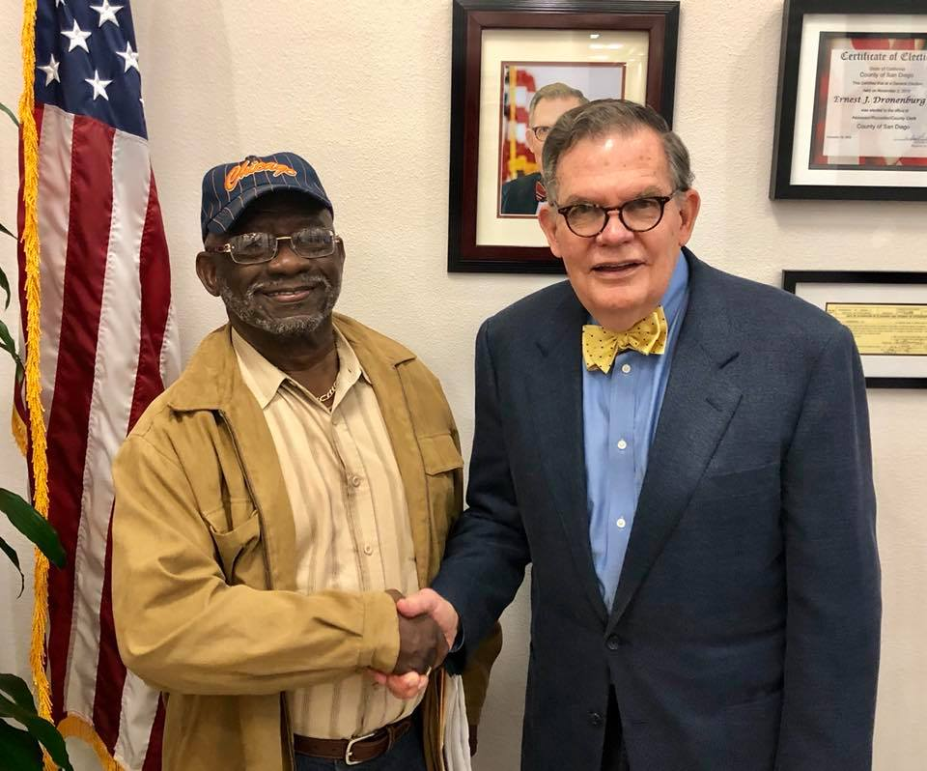
Thank You for your service!
Jordan Marks, Esq.
Taxpayer Advocate
Assessor/Recorder/County Clerk 1600 Pacific Highway, Room 110 San Diego, CA 92101
Cell: (619) 372-0226
Jordan.Marks@sdcounty.Ca.Gov

